Slide 1
CAPTURE THE PACKET
COMPUTER NETWORKS AND SECURITY
PRESENTER:
2010030323 - M. Haneesh
2010030384 - Mounika
2010030372 - P. Lahari
2010030421 - Rithvik
GUIDE:
Dr.P Lalitha Surya Kumari

Slide 2
INDEX:
1.Abstract
2.Introduction
3.Flow chart
4.Github-commits
5.Work progress
6.Methodology
7.Implementation

Slide 3
ABSTRACT:
This presentation contains the detailed description of the project “Packet Capture”
Packet Capture refers to the action of capturing Internet Protocol (a set of rules which says how data should be delivered) packets that travel across the network layer of the Internet Protocol layer for review or analysis.
A full packet includes two things: a payload and a header. The payload is the actual contents of the packet, while the header contains metadata, including the important data such as the source, destination address, packet type and size, and related details.
After packet is captured in, it is stored for a period of time so that it can be analyzed.
Once the raw packet data is captured, the packet sniffer analyzes it and presents it in a readable form so that the person using the software can understand it. The person analyzing the data can view details of the interaction between two or more nodes on the network.
This information is to determine where a fault lies, such as determining which device failed to respond to a network request.

Slide 4
INTRODUCTION:
Nowadays, As more people communicate through Internet, network has grown tremendously and become more complex. This has lead to a challenge to protect the network from any threats and solve the network problems. Hence, It is used for network troubleshooting and communication protocol analysis. This system is useful for a network administrator who needs to identify, diagnose, and solve network problems like a company manager who wants to monitor user activities on the network and ensure that the corporation’s communications assets are safe, or a consultant who has to quickly solve network problems for clients.

Slide 5
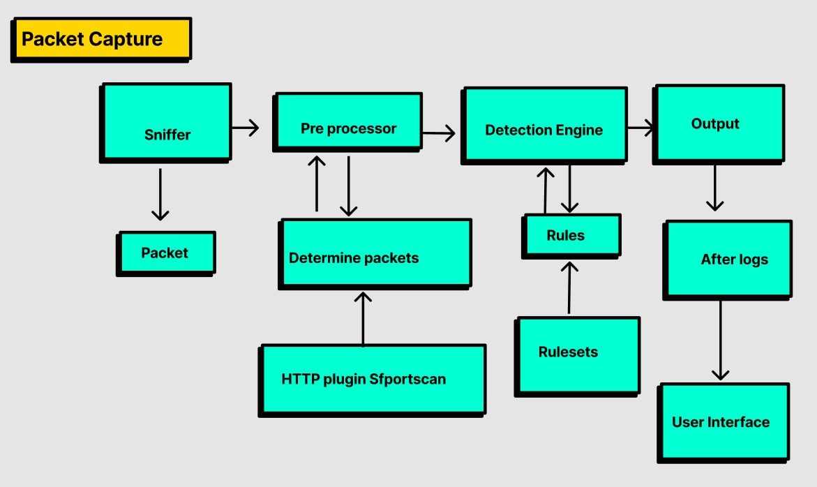
FLOWCHART:

Slide 6
WORK PROGRESS:
FINISHED
1. Code Completion
2. Electron setup (framework for building a desktop application using javascript )
TO DO
Embedding python code in electron framework.

Slide 7
Prerequisite:-
install python
install node js
Methodology:-
Capturing Packets:-
Writing a python code to make the network interface into monitoring mode and capturing packets with the given interface
User Interface:-
Create a react app with electron which is used to create Desktop applications where we can select from which network interface we can capture

Slide 8
THANK YOU.

